Slide 1
Microsoft 365 Enterprise
Licensing overview
June 2023
Latest diagrams available here:
https://m365maps.com

Slide 2
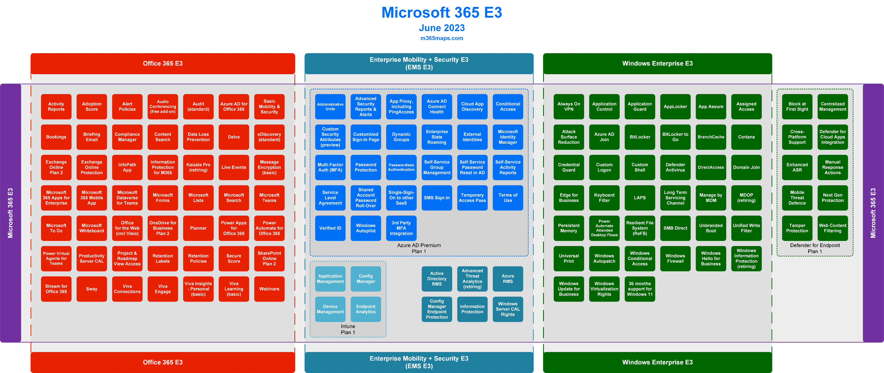
Microsoft 365 E3

Slide 3
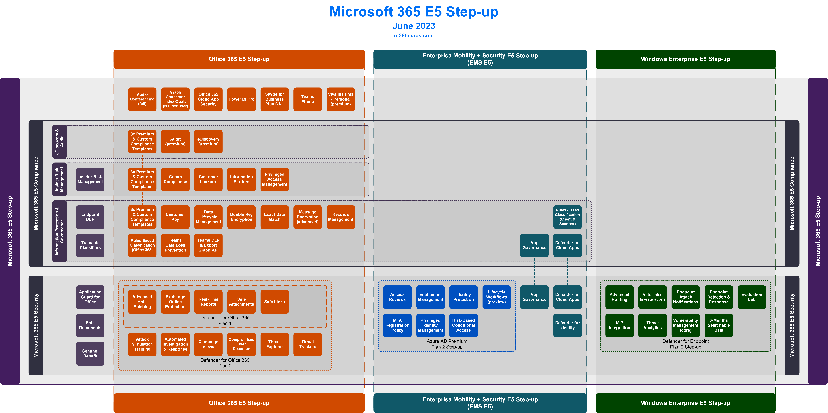
Microsoft 365 E5 Step-up

Slide 4
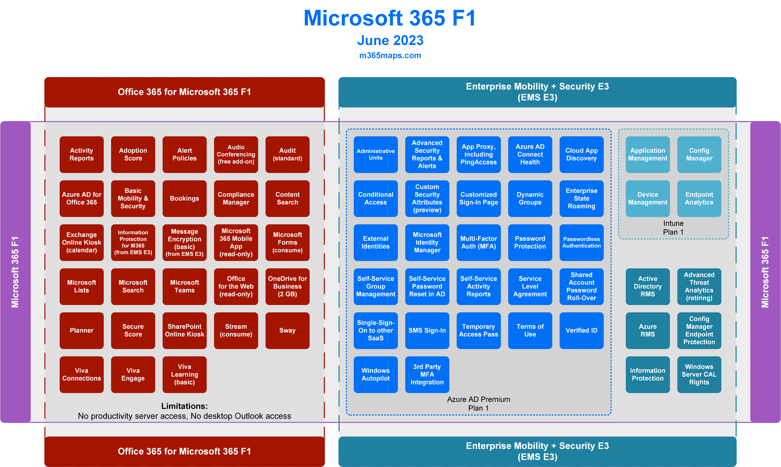
Microsoft 365 F1

Slide 5
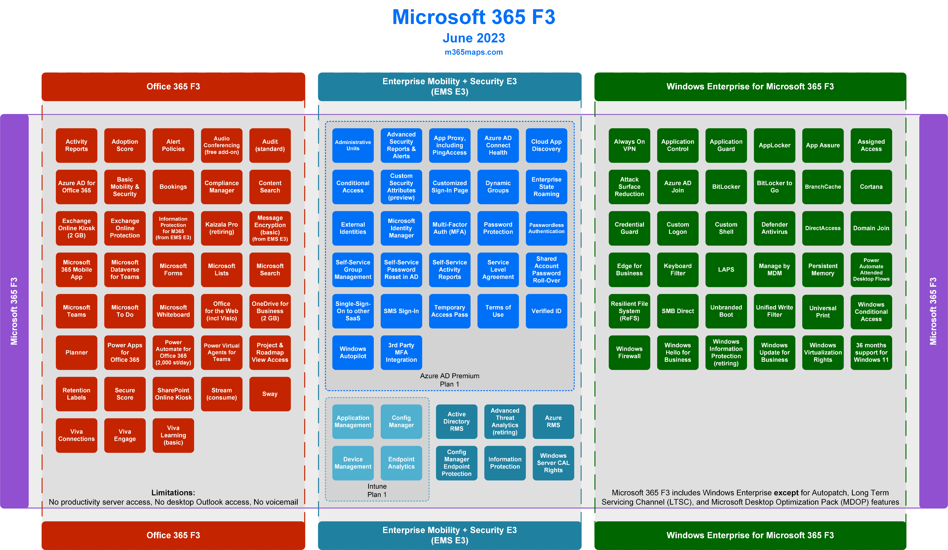
Microsoft 365 F3

Slide 6
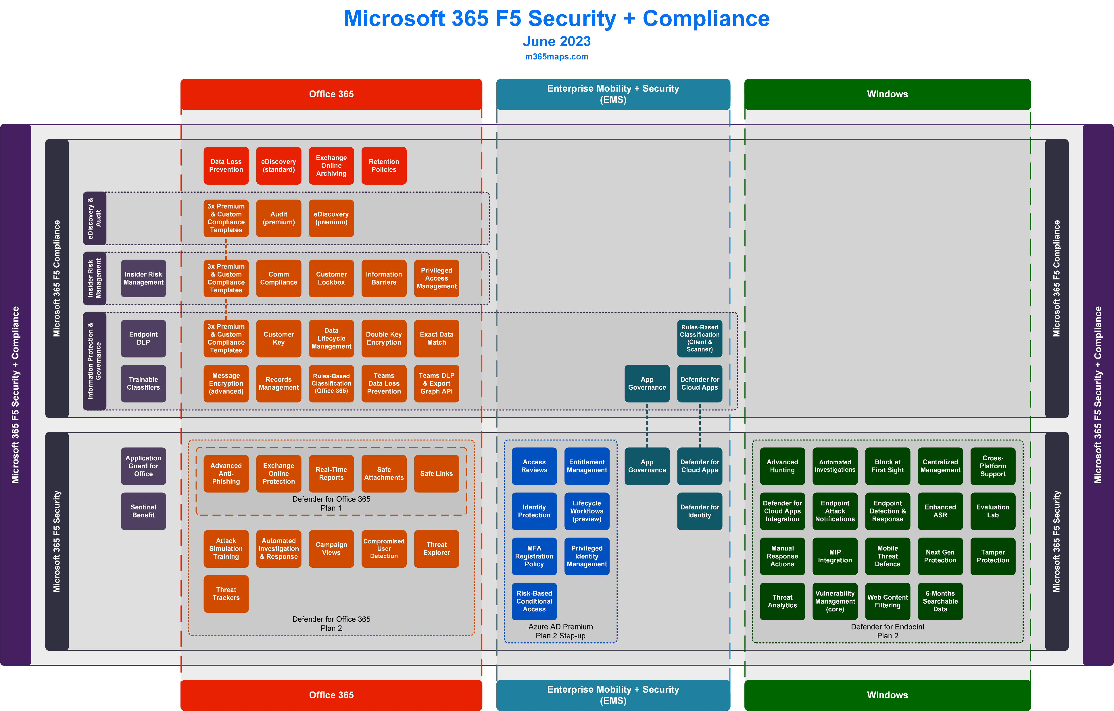
Microsoft 365 F5 Security + Compliance

Slide 7
Microsoft 365 Business
Licensing overview
June 2023
Latest diagrams available here:
https://m365maps.com

Slide 8
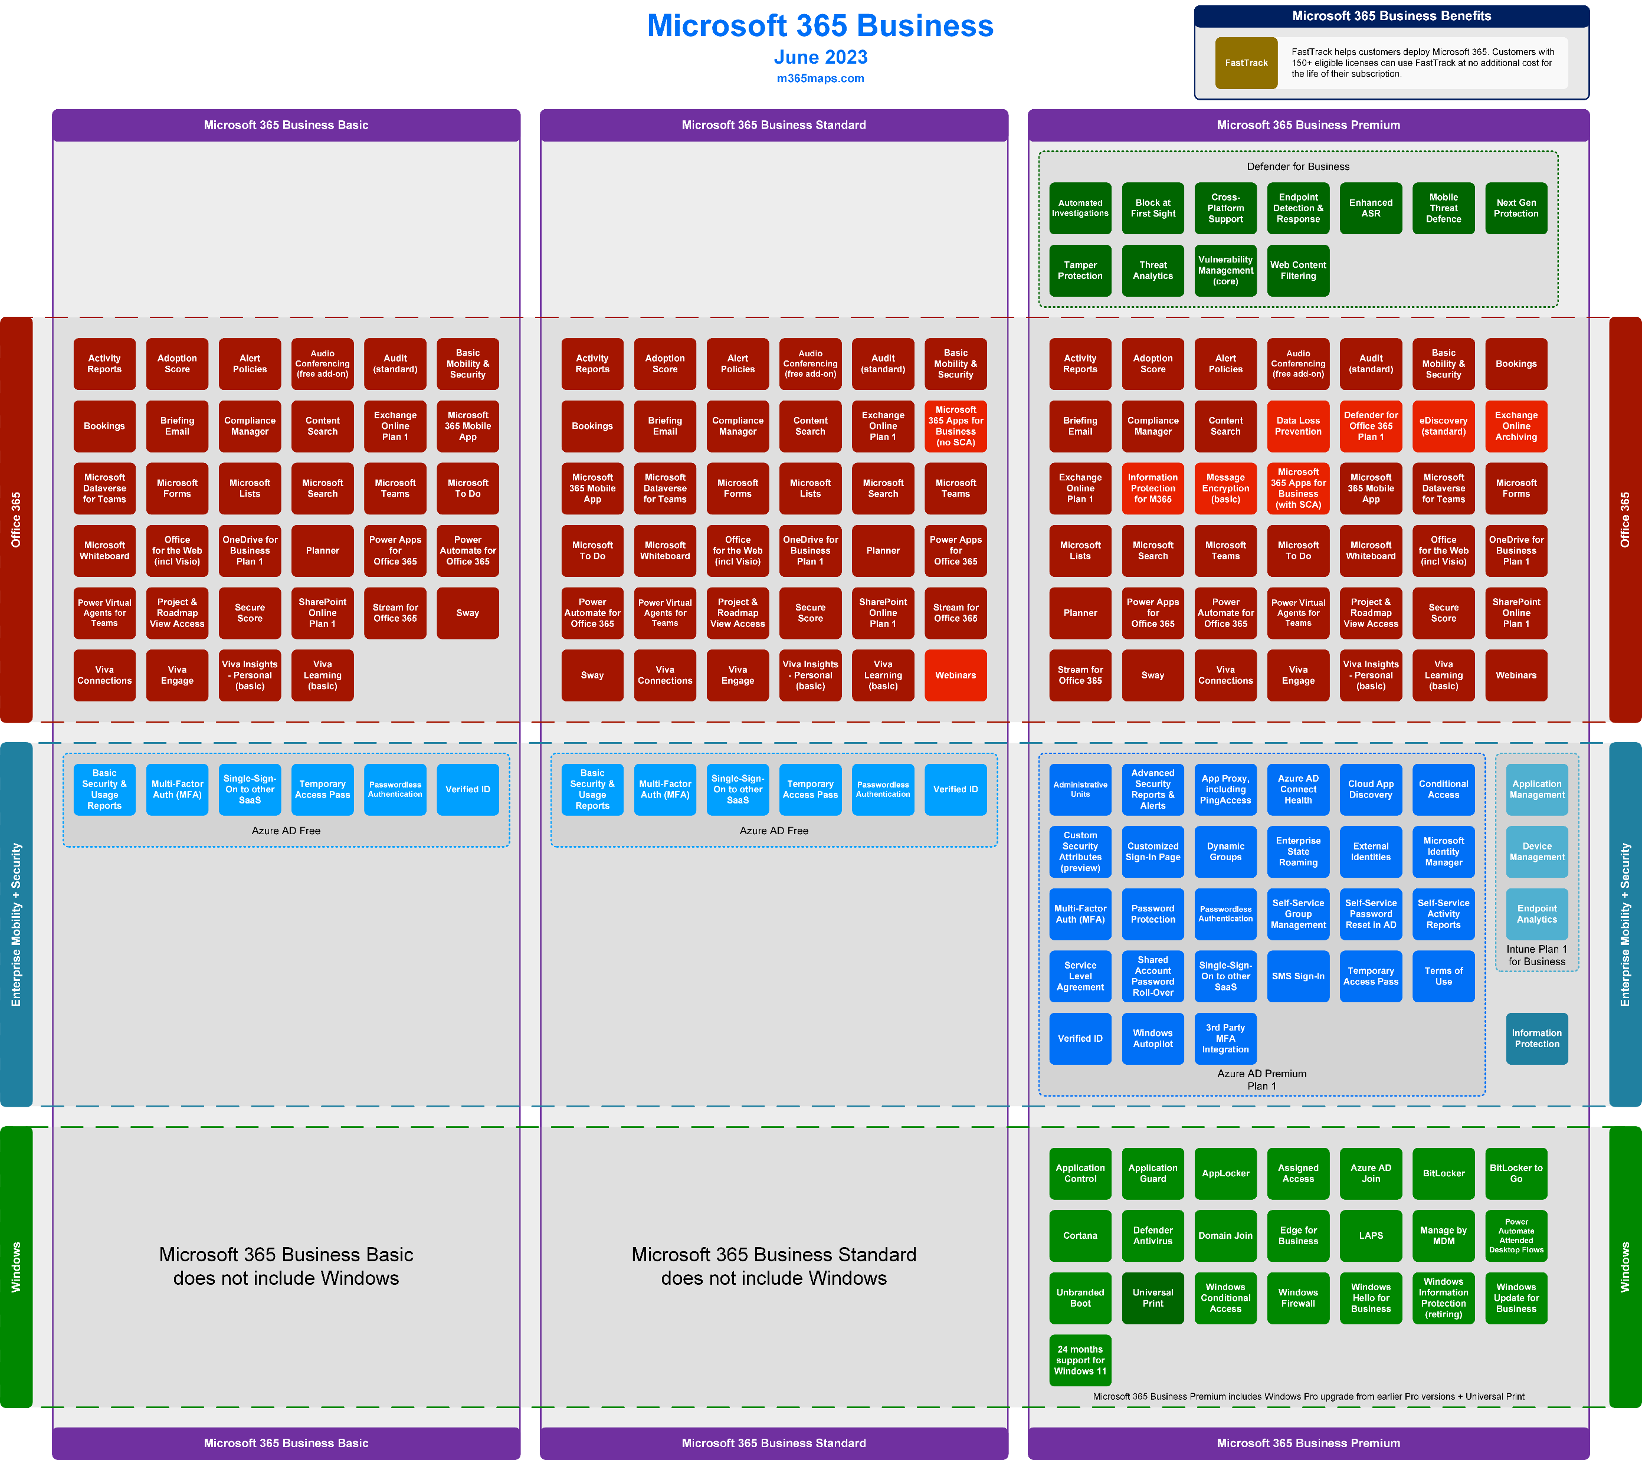
Microsoft 365 Business (All)

Slide 9
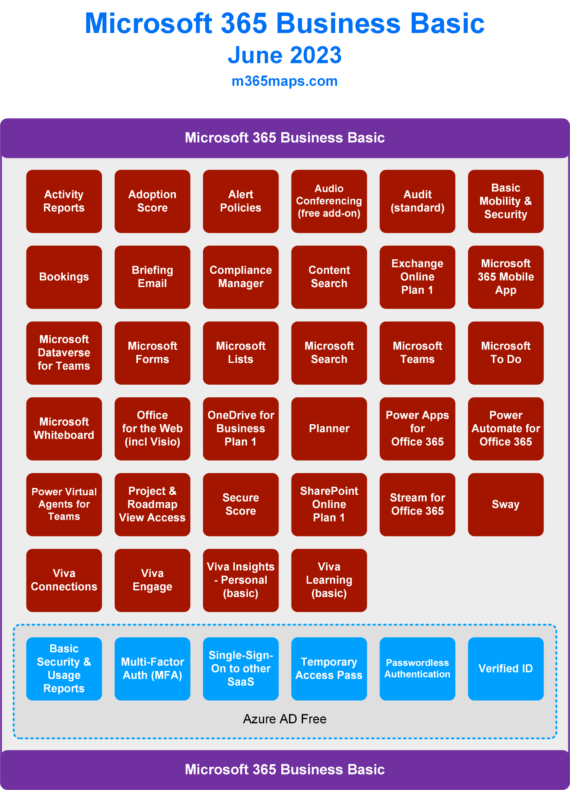
Microsoft 365 Business Basic

Slide 10
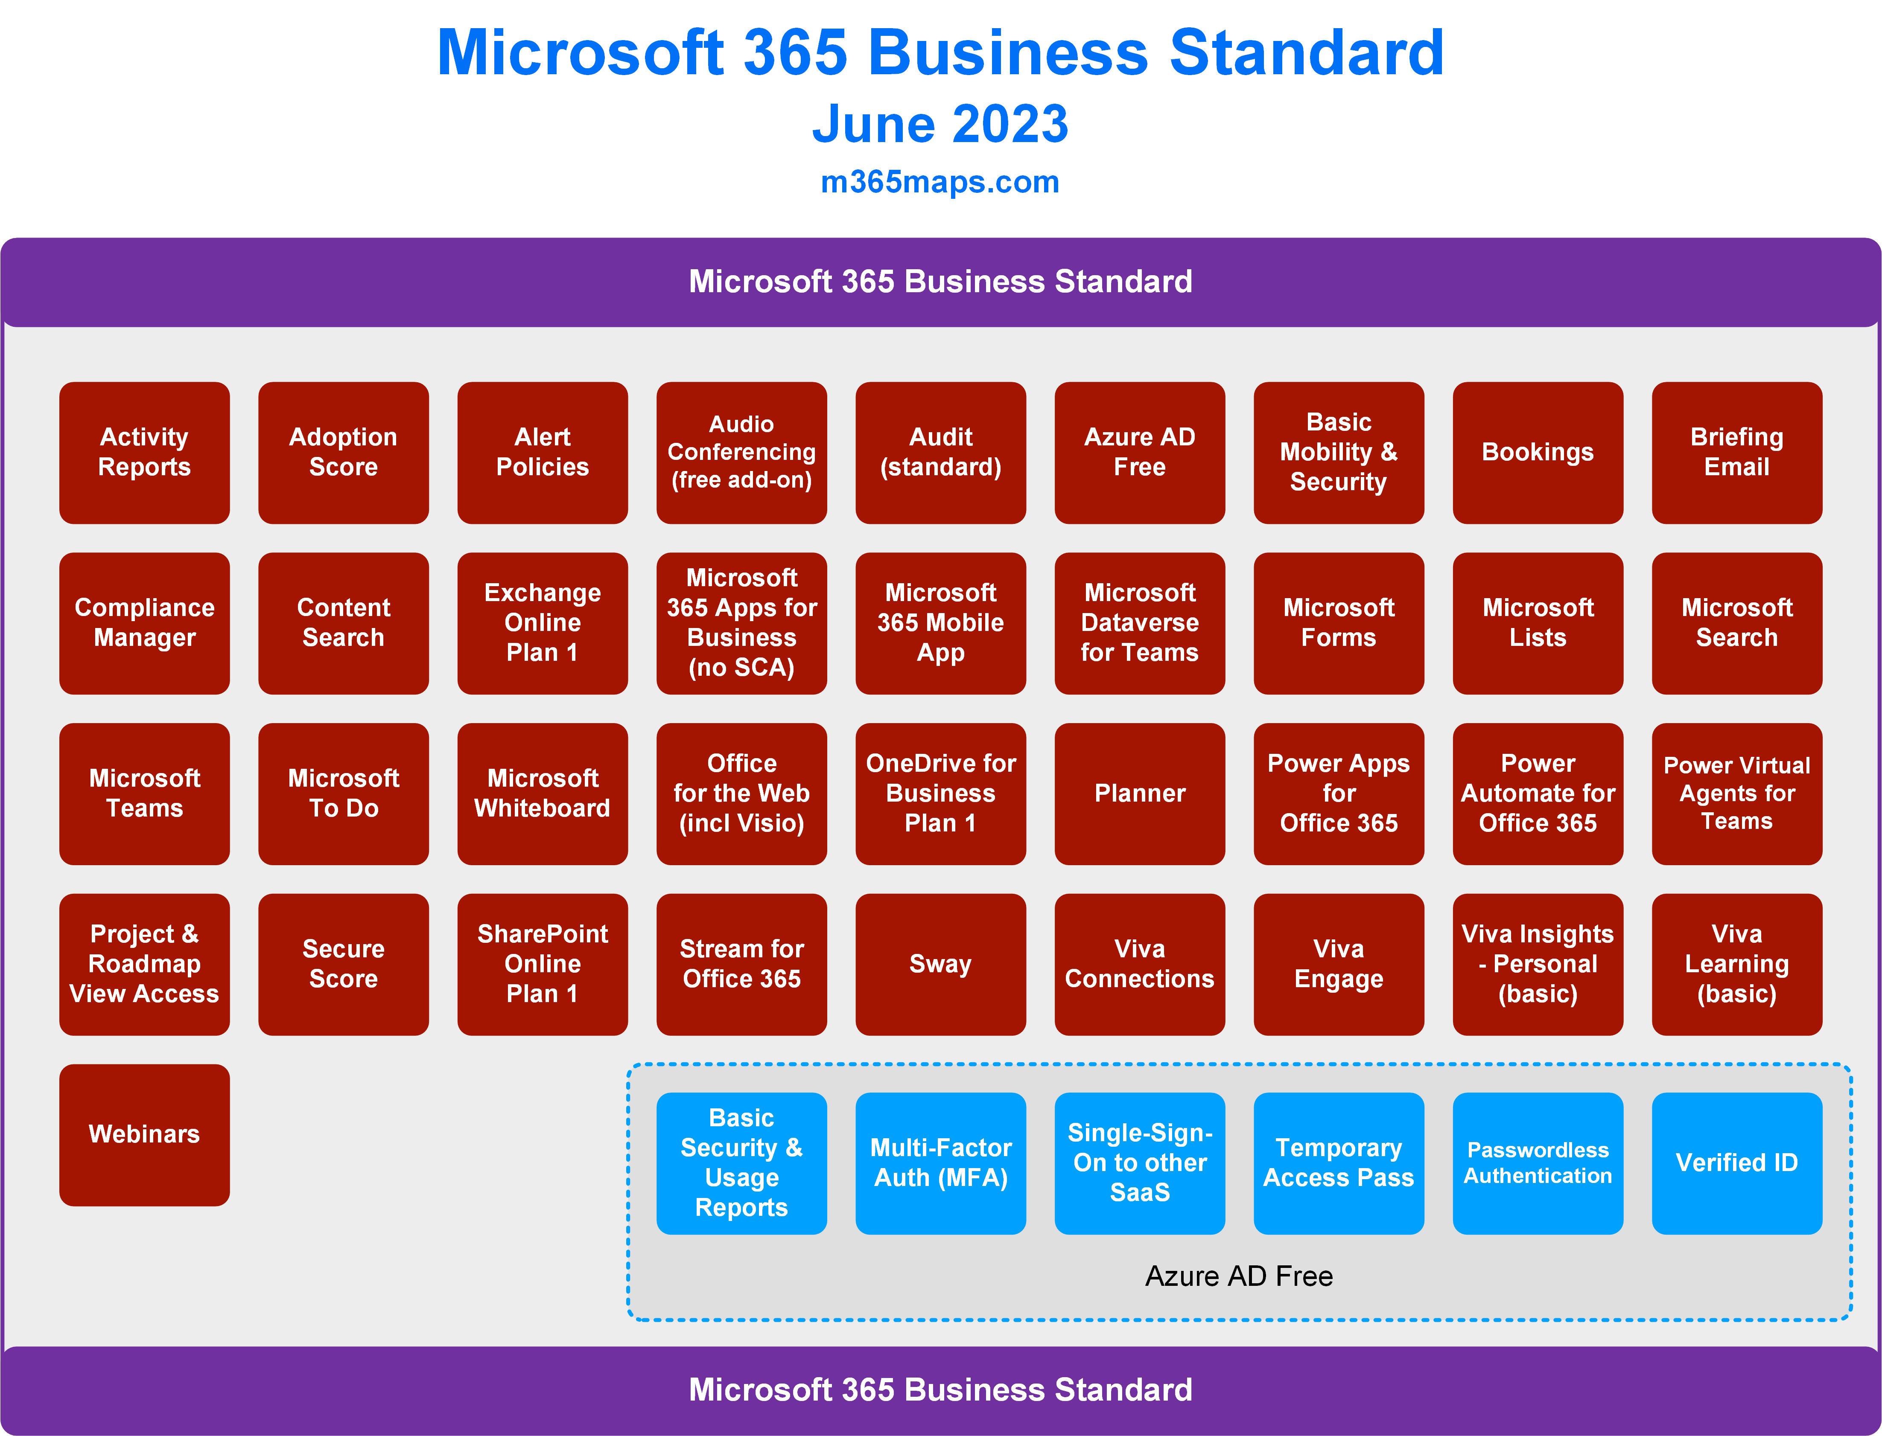
Microsoft 365 Business Standard

Slide 11
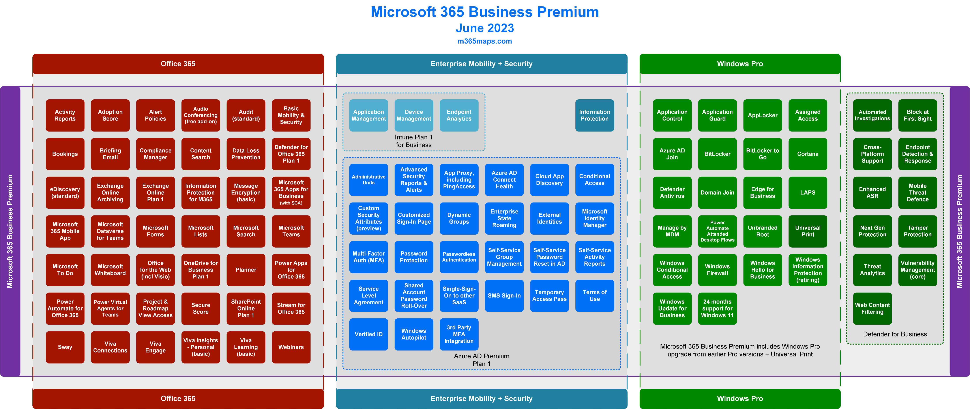
Microsoft 365 Business Premium

Slide 12
Microsoft 365 Related Services
June 2023
Latest diagrams available here:
https://m365maps.com

Slide 13
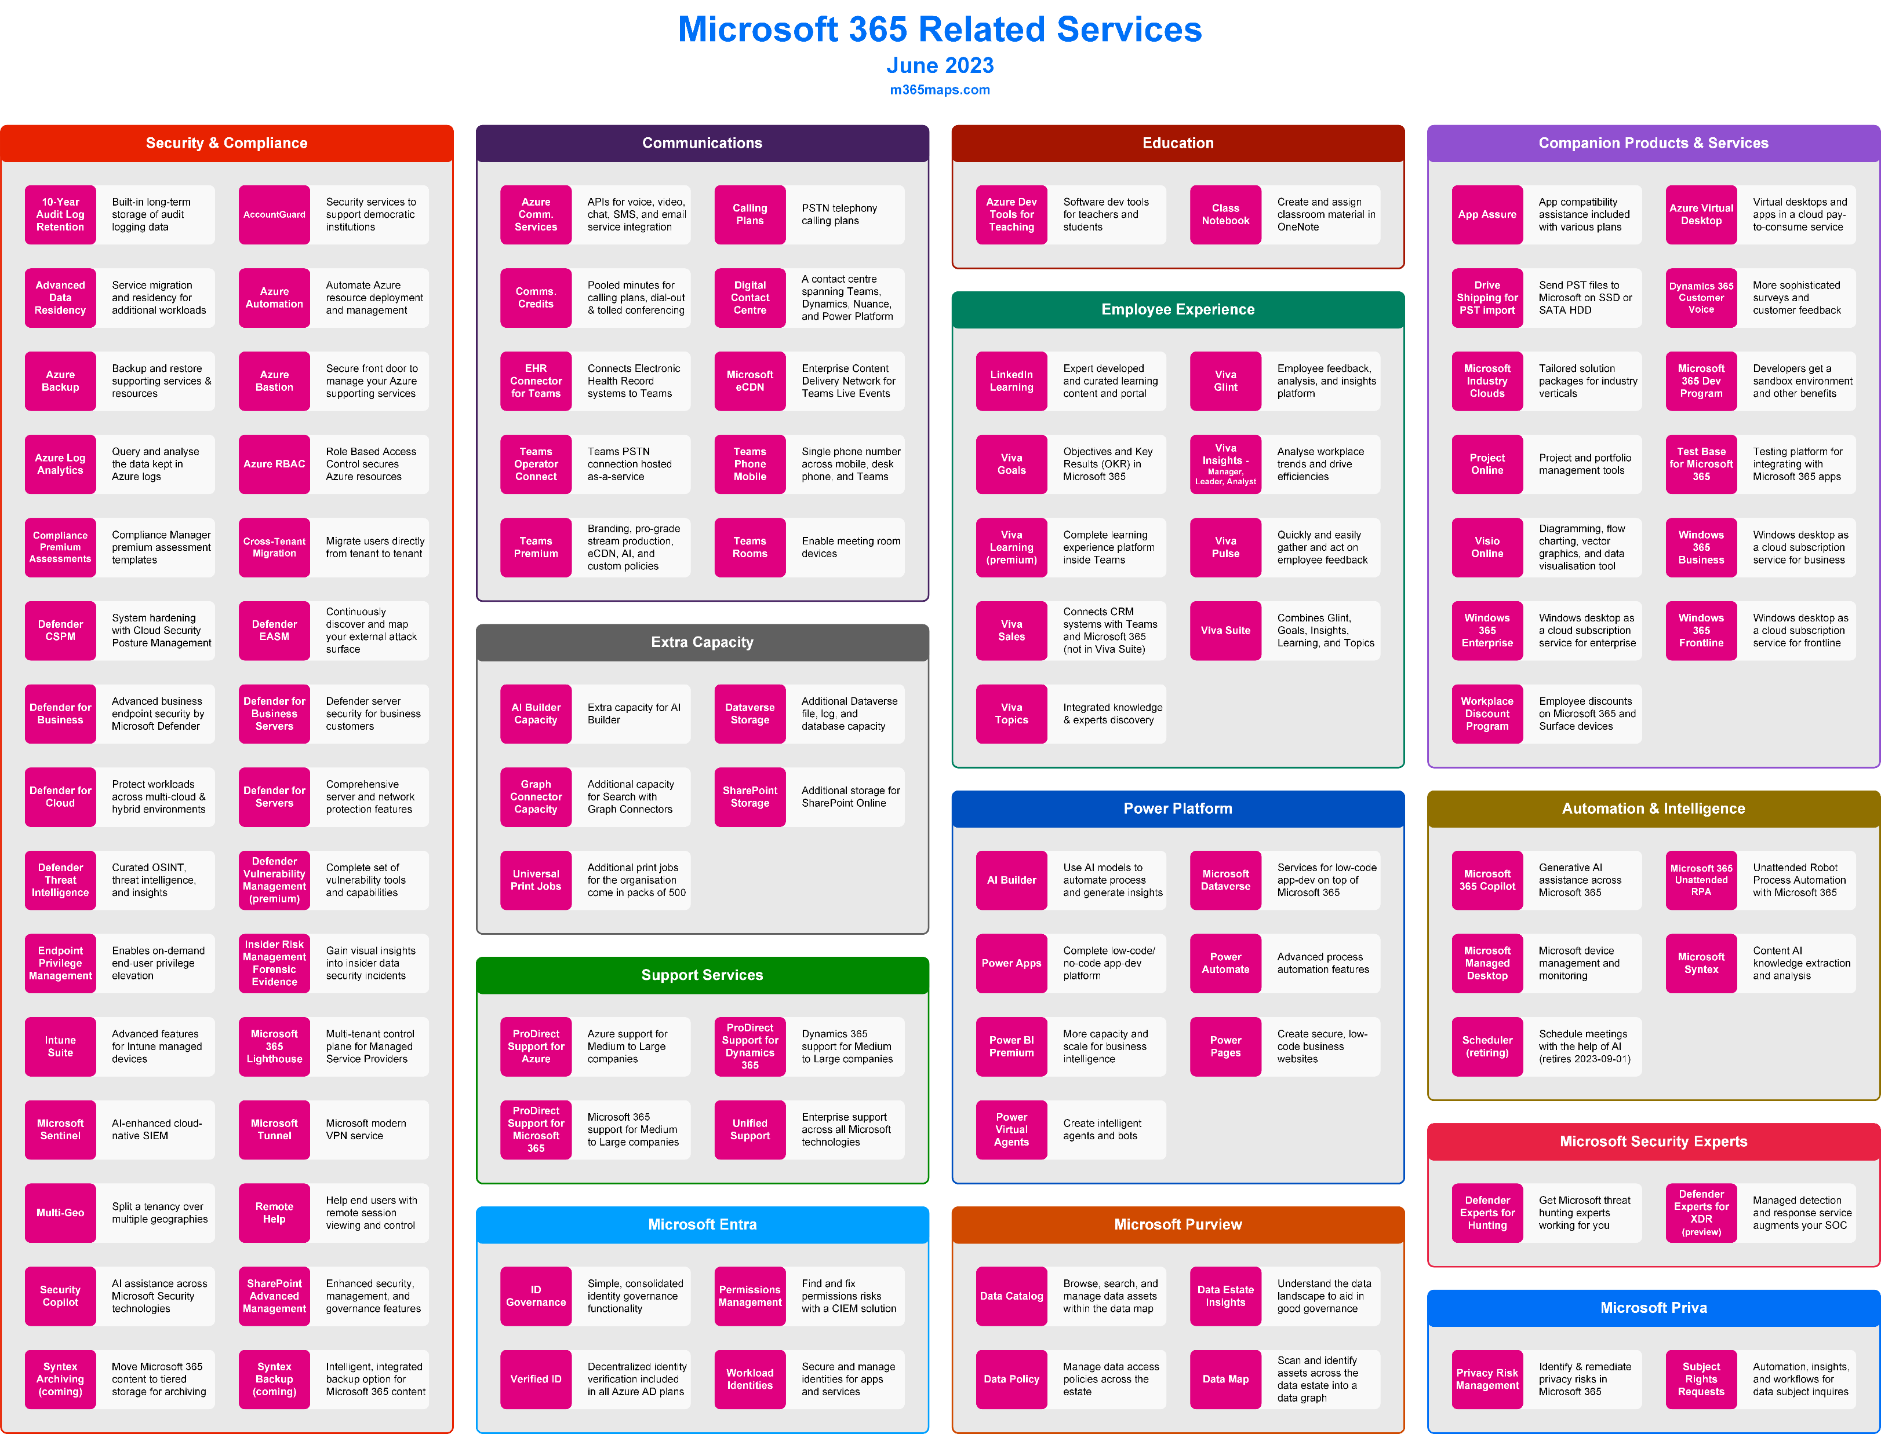
Related Services

Slide 14
Links
Website https://m365maps.com/ Updates on Twitter and LinkedIn https://twitter.com/AaronDinnage https://www.linkedin.com/in/aarondinnage/

